Slide 1
Introduction and Security Principles
ITIS 6200/8200 Fall 2023 - Lecture 1

Slide 2
First Half of Today: Introductions and Logistics
Staff introductions
Course overview:
What will you learn in this class?
Course logistics
Lectures, discussions, office hours, and exams
Resources and communication platforms
Collaboration and academic honesty
DSP and extenuating circumstances
Stress management and mental health
Ethics
Case studies and blue slides
What is security? Why is it important?

Slide 3
Staff Introductions

Slide 4
Who Am I? Professor Xiang (shaang) (he/him)
Did my undergrad in China
Electronic Engineering
Did a PhD at University of Virginia (UVa)
Research focus: formal methods; dependability
Advisors: John Knight
Did a 5 year Postdoc at Harvard University
Research focus: formal methods for security; information flow analysis, Cyber-physical systems
Advisors: Stephen Chong
First-year assistant professor in SIS
First time teaching a complete class, so your feedback/advice/complaints are appreciated!
Feel free to call me “Jian” (jee·en)!

Slide 5
Our TAs!
Vineeth Mylavarapu (Linkedin, email)
Office Hours
Time: Monday 7-8pm
Location: COED-065, College of Education Building
Video call link: https://meet.google.com/xde-dmob-ipa
Tarun Grandhi
Office Hours
Time: Wednesday 6-7pm
Location: Conference room 309, Woodward Hall
Video call link: https://meet.google.com/irn-doeo-uhr

Slide 6
Course Overview

Slide 7
Learning Objectives
Understand fundamental concepts of security
Understand security vulnerabilities, threats and their significance
Understand how attacks work in practice
Understand security properties, and build computer systems with robust security properties
What mistakes not to make!
Notes:
“If I find out you start a new project in C or C++, or use unescaped SQL, or allow your web site to support CSRF attacks… MY SPIRIT WILL REACH THROUGH YOUR MONITOR AND STRANGLE YOU!!!!” ~Nick

Slide 8
Course Outline
Introduction to Security
What are some general philosophies when thinking about security?
Cryptography
How do we securely send information over an insecure channel?
Web Security
What are some attacks on the web, and how do we defend against them?
System Security
What are some attacks on computer systems, and how do we defend against them?
How do attackers exploit insecure software? How do we defend against these attacks?
Assurance of Security
How to establish/prove security properties for computer systems? (My research)
Miscellaneous Topics
Useful, interesting, or fun topics. Maybe some guest lectures! e.g., CPS security

Slide 9
Extra Tools and Skills
Some non-security-related skills you can take away from this class:
Cryptography
Becoming a better consumer: Be able to analyze security products and pick the right security tools for your software
Web Security
Software engineering: Understanding how websites are built and how your web browser interacts with remote web servers
System Security
Architecture and OS: Understand how the memory works and how you software application interact with OS and hardware
Assurance of Security
Mathematical notations, system modeling, and proof methods

Slide 10
Prerequisites
No course requirement; but the following skills help
Familiarity with basic mathematical notation and proof structures
Relevant for the cryptography unit, and assurance of security
We’ll add useful resources as we encounter it during the cryptography lectures
Familiarity with memory layouts and assembly
Relevant for system security
We’ll add useful resources as we go
An ability to pick up new programming languages quickly
Projects may need it
Notes:
61C: It's possible to do well in the class even if you did poorly in 61C or didn't take 61C!
Programming languages: As an upper-division class, we will be holding your hand less and trusting you to get your hands dirty on your own

Slide 11
Course Logistics

Slide 12
Enrollment
Course staff does not control enrollment; we have to follow department policy
For course registration issues, please contact Katie Watson at katie.watson@charlotte.edu
Waitlisted students should be enrolled once reserved seats disappear

Slide 13
Course Structure: Lectures
You are expected to be here! This is a in-person class
Tuesday/Thursday, 10:00–11:15 AM
Attendance is not taken

Slide 14
Course Structure: Office Hours
Space to ask questions about content, get help with projects, raise concerns with the course, etc. with a TA or instructor
Office hours schedule available at https://fa22.cs161.org/calendar
Office hours queue at https://oh.cs161.org/
All office hours start next week (week of August 29)
All office hours will be available both in-person and online

Slide 15
Course Structure: Exams
Midterm: Tentatively Friday, October 7th, 7:00–9:00 PM PT
Backup date: Tuesday, October 11, 7:00–9:00 PM PT
Trying to move from 11th to 7th to avoid CS 168/CS 188 conflicts
Final: Friday, December 16th, 3:00–6:00 PM PT
Online and alternate-time exams will be offered
For exam security, we may not be able to offer remote exams after the regular time
For exam security, we may not be able to offer next-day exams
Forms to request online/alternate exams will be released closer to the exam

Slide 16
Resources
Textbook: https://textbook.cs161.org/
Free! There’s no textbook you need to pay for.
Readings are optional, but past students have said the textbook is helpful
Course website: https://fa22.cs161.org/
Course schedule, lecture slides, assigned readings, and other resources are all posted here
Notes:
We wrote this textbook ourselves to supplement lecture content

Slide 17
Platforms
Ed
Discussion forum (replacement for Piazza)
Course-related communication should take place in Ed or happen in office hours
For private matters, you can make a private post
Please don’t post publicly about project spoilers!
Gradescope
All assignments are submitted and graded on Gradescope
Email
cs161-staff@berkeley.edu for private matters
Ed response is faster, but staff will monitor the email if you’re more comfortable with that

Slide 18
Grading Structure
Homework: 10%
Completed individually
For now, 7 homeworks in total, weighted equally
Some homeworks will involve hands-on lab components
Gradescope with instant feedback: You can keep trying until you get the answer right
Reduced credit for submitting late (no credit after 3 days late, unless you have an extension)
Projects: 40%
P1 = 10%, P2 = 20%, P3 = 10%
Completed individually or in groups of 2
Reduced credit for submitting late (no credit after 3 days late, unless you have an extension)
Midterm: 20%
Final: 30%

Slide 19
Class Policies: Extensions
We do not have slip days or assignment drops in this course!
However, you can request extensions on any assignment for any reason:
Extensions form linked at the top of the website
Extensions ≤3 days will be automatically approved if submitted before the deadline
Longer extensions may be approved, but we’ll need to check in first to make sure you’re on pace to finish the class
It is okay to request an extension if things come up! We’re here to support you!
Life happens.
You can always request an extension for any reason (e.g. stress, other classes, etc.)
We want to keep deadlines to make sure you’re on track to finish, while reducing the associated stress

Slide 20
Class Policies: DSP
Disabled Students’ Program (DSP)
There’s a variety of accommodations UC Berkeley can help us set up for you in this class
https://dsp.berkeley.edu/
Are you facing barriers in school due to a disability?
Apply to DSP!
We maintain proper access controls on this information: Only instructors, course managers, head TAs, and logistics TAs can access any DSP-related info
Our goal is to teach you the material in our course. The more accessible we can make it, the better.

Slide 21
Class Policies: Collaboration
Asking questions and helping others is encouraged
Discussing course topics with other is welcome!
The class is graded using grading bins, so you aren’t graded against your peers
Limits of collaboration
Don’t share solutions with each other (except project partners)
You should never see or have possession of anyone else’s solutions—including from past semesters

Slide 22
Class Policies: Academic Honesty
We’re here to help! There are plenty of staff and resources available for you
You can always talk to a staff member if you’re feeling stressed or tempted to cheat
Academic dishonesty policies
At minimum, the student will receive negative points on the assignment
Example: If the midterm is worth 150 points, the student will receive a score of -150 on the midterm.
The student will be referred to the Center for Student Conduct
CSC often doesn’t care that much about first-time cases! They are there to make sure a student doesn’t make the same mistake a second time.
If you take the class honestly, you don’t need to worry about these!

Slide 23
Class Policies: Academic Honesty
As a computer security class, we view potential cheaters as “attackers.”
Our threat model assumes “rational” attackers.
A rational attacker will only launch an attacker if (expected benefit) > (expected cost)
(expected cost) = (cost of launching attack) + (cost of getting caught) * (probability of getting caught)
Two-fold approach to academic integrity:
Detection: Use our tools to analyze and detect instance of academic dishonesty.
You will learn that “security through obscurity” is bad, but obscurity can help. We have ways.
Response: At minimum, you will receive negative points on the assignment.
Notes:
“We will go to DEFCON 1 (aka "launch the nukes") immediately” ~Nick

Slide 24
Ethics
In this class, you will learn a lot about attacks out of necessity
To be able to defend against the attacker, you must learn the techniques that attackers use
It is usually okay to break into your own systems
This is a great way to evaluate your own systems
It is usually okay to break into someone else’s systems with their explicit permission
It is grossly unethical and exceedingly criminal to break into someone else’s systems without their permission

Slide 25
Stress Management and Mental Health
We want to reduce your stress where we can
Project 2 (mid-semester) is going to be the most intensive part of this class, but we’ve made things lighter towards the end (when every other class has stuff due)
Your health is more important than this course
If you feel overwhelmed, there are options
Academically: Ask on Ed, talk to staff in office hours, set up a meeting with staff to make a plan for your success this semester
Non-academic:
Counselling and Psychological Services (CAPS) has multiple free, confidential services
Casual consultations: https://uhs.berkeley.edu/counseling/lets-talk
Crisis management: https://uhs.berkeley.edu/counseling/urgent
Check out UHS’s resources: https://uhs.berkeley.edu/health-topics/mental-health

Slide 26
Case Studies and Blue Slides
Security is often best taught through real-world case studies and stories
Lectures will sometimes use real-world examples to demonstrate concepts
Slides with a blue background are case study slides
Content on blue slides are not tested on exams
You do not need to remember the exact details of the story
Some blue slides will end in a takeaway that describes the moral of the story
You do need to understand the takeaway from the story

Slide 27
What is security?

Slide 28
What is security?
Enforcing a desired property in the presence of an attacker
data confidentiality
user privacy
data and computation integrity
authentication
availability
…

Slide 29
Why is security important?
It is important for our
physical safety
confidentiality/privacy
functionality
protecting our assets
successful business
a country’s economy and safety
and so on…

Slide 30


Why is security important?
Consider: Physical Safety
 | Link
FBI probe of alleged plane hack sparks worries over flight safety
Drew Harwell | May 18, 2015
 | Link
Pacemaker hack can kill via laptop
Jeremy Kirk | October 21, 2012

Slide 31


Why is security important?
Consider: Privacy/Confidentiality
 | Link
91 Percent of Healthcare Organizations Suffered Data Breaches in the Past Two Years
Jeff Goldman | May 12, 2015
 | Link
Data Breach Tracker: All the Major Companies That Have Been Hacked
Karavbrandeisky | October 30, 2014
In 2020, there were over 1001 breaches, affecting the data of 155,000,000 individuals
Notes:
Source: Identity Theft Resource Center

Slide 32

Why is security important?
Consider: National security
 | Link
America’s Electric Grid Has a Vulnerable Back Door—and Russia Walked Through It
Rebecca Smith and Rob Barry | January 10, 2019
A Wall Street Journal reconstruction of the worst known hack into the nation’s power system reveals attacks on hundreds of small contractors

Slide 33

What is hackable?
Everything!
Especially things connected to the Internet
Assume that every system is a target
A casino was hacked because a fish-tank thermometer was hacked within the network
 | Link
For the First Time, Hackers Have Used a Refrigerator to Attack Businesses
Julie Bort | January 17, 2014
Notes:
“If it can kill you, don’t connect it to the Internet!” ~Nick

Slide 34
Security Principles
Textbook Chapter 1
Notes:
Soon, we will get into really technical details and attacks and learn to actually exploit (and defend) computer systems
But the rest of lecture will be focused on some of the philosophical concepts that underpin everything in the rest of the course

Slide 35
Second Half of Today: Security Principles
Security principles
Know your threat model
Consider human factors
Security is economics
Detect if you can’t prevent
Defense in depth
Least privilege
Separation of responsibility
Ensure complete mediation
Don’t rely on security through obscurity
Use fail-safe defaults
Design in security from the start
Notes:
We will start the study of security with some key principles in designing secure systems that we will use throughout the class. You will see them appearing in different scenarios across different parts of security.
Soon, we will get into really technical details and attacks and learn to actually exploit (and defend) computer systems
But the rest of lecture will be focused on some of the philosophical concepts that underpin everything in the rest of the course

Slide 36
Know Your Threat Model
Textbook Chapter 1.1 & 1.12

Slide 37
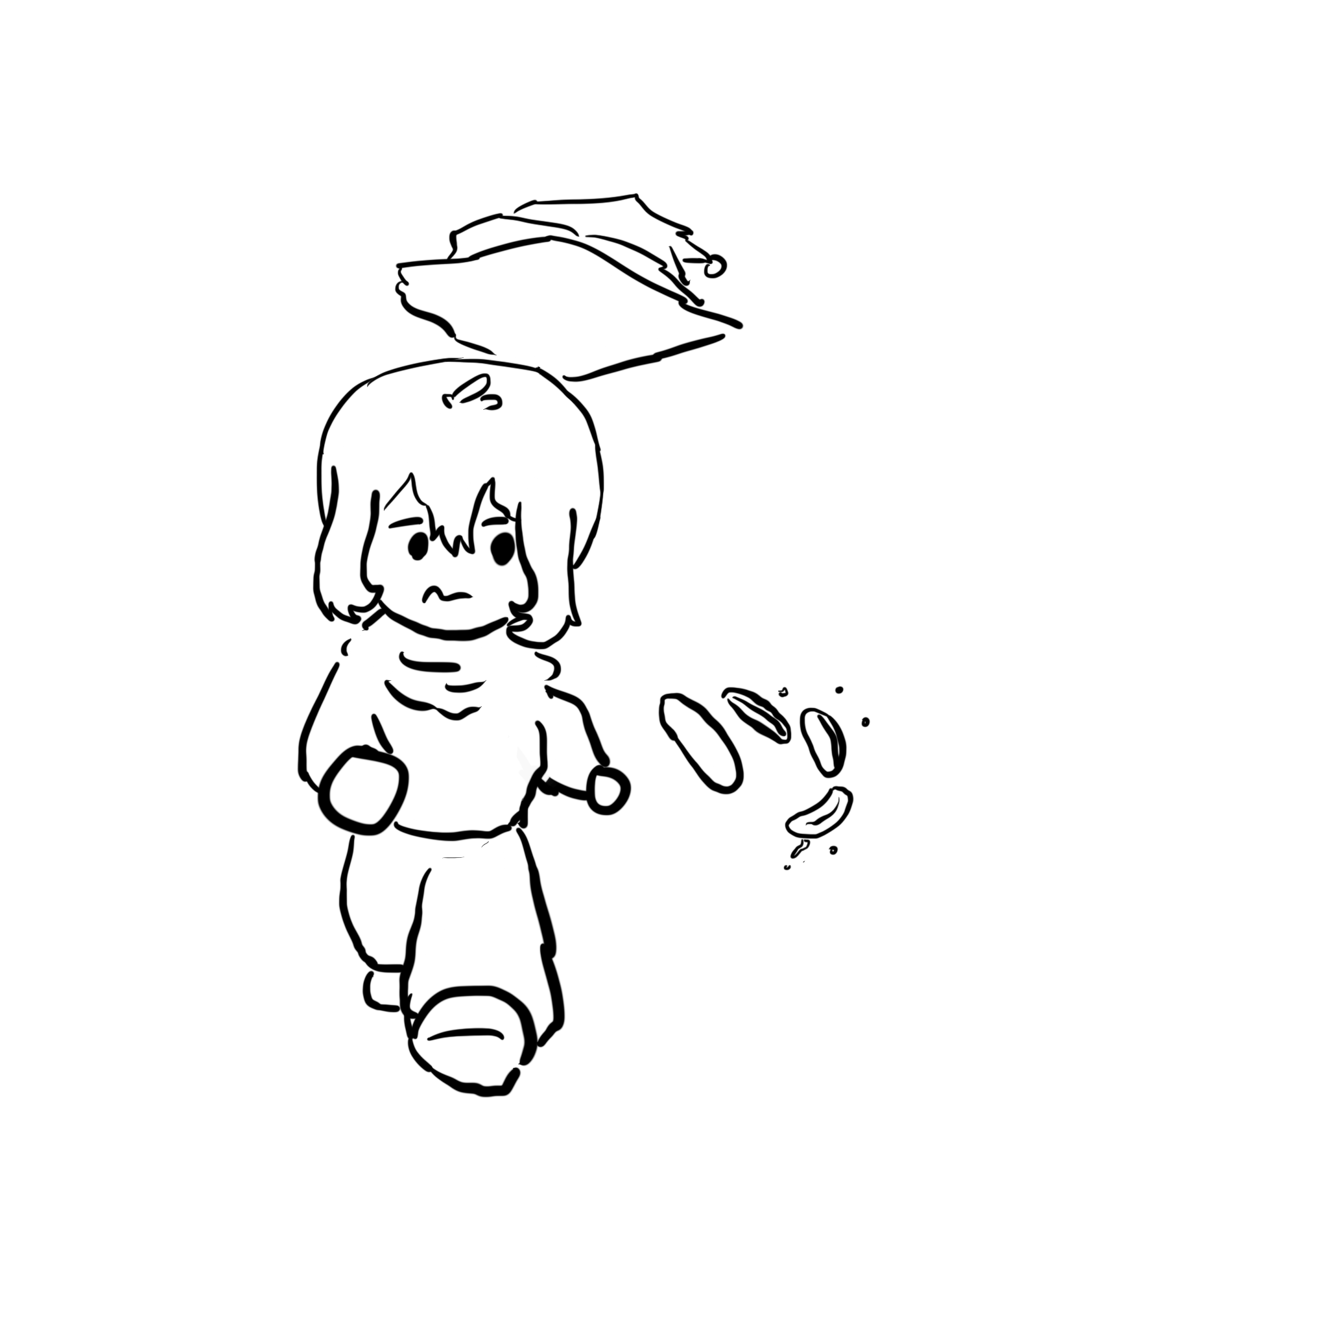

The Parable of the Bear Race
Reminder: blue slides are case studies. Remember the takeaway, not the story!
“I don’t have to outrun the bear. I just have to outrun you.” Takeaway: You often just need to have “good enough” defense to make attackers turn somewhere else.
Notes:
“Two hikers are out in the woods, going for a walk. Up behind them comes a huge grizzly bear, rising up and roaring at them. One hiker, really scared, goes ‘Oh god, oh god, it’s a bear, what are we going to do?’ The other hiker calmly takes off his pack and starts to tie his shoes. The first hiker says to the first, ‘Why are you not worried?’ The second hikers says, ‘You know, I don’t have to outrun the bear. I just have to outrun you.’”

Slide 38




Security Principle: Know Your Threat Model
Threat model: A model of who your attacker is and what resources they have
It all comes down to people: The attackers
No attackers = No problem!
One of the best ways to counter an attacker is to attack their reasons
Why do people attack systems?
Money
Politics
Fun
Watching the world burn
Notes:
“We are sick of playing whak-a-mole on bad guys… Instead we play whak-a-mole on bad-guy business models”

Slide 39
Security Principle: Know Your Threat Model
Consider: Personal security
Who and why might someone attack you?
Criminals might attack you for money
Teenagers might attack you for laughs or to win online games
Governments might spy on you to collect intelligence
Intimate partners might spy on you
This is a surprisingly dangerous threat model!
Notes:
Intimate partners: Consider their physical access, intimate knowledge, social engineering skills, and motivation to target a particular person
Turn your phone into a bug and location tracker: its easy if your phone is in their hands and they know the password...
I had a colleague who's ex broke into his Facebook account: by abusing the 3-friends password reset option
A good summary from Karen Levy https://slate.com/technology/2018/03/apps-cant-stop-exes-who-use-technology-for-stalking.html

Slide 40
The National Security Agency (NSA)
Stated purpose: To collect information to protect US national security
Since its founding in 1952, the NSA has:
Decoded secret enemy communications in wars
Spied on people in the US and other countries (sometimes legally, sometimes illegally)
Participated in security research and helped develop security standards
Developed secret techniques for surveillance and cyberattacks
For better or worse, the NSA are an essential part of computer security
We’ll see many stories with the NSA this semester

Slide 41
Threat Model: Common Assumptions for Attackers
Assume the attacker…
Can interact with systems without notice
Knows general information about systems (operating systems, vulnerabilities in software, usually patterns of activity, etc.)
Can get lucky
If an attack only succeeds 1/1,000,000 times, the attacker will try 1,000,000 times!
May coordinate complex attacks across different systems
Has the resources required to mount the attack
This can be tricky depending on who your threat model is
Can and will obtain privileges if possible
Notes:
Interacting with systems: You may not always detect the attacker probing your systems before launching an attack
Resources: The NSA can mount a larger-scale attack than an individual criminal
“We are sick of playing whak-a-mole on bad guys… Instead we play whak-a-mole on bad-guy business models”

Slide 42
Trusted Computing Base
Trusted computing base (TCB): The components of a system that security relies upon
Properties of the TCB:
Correctness
Completeness (can’t be bypassed)
Security (can’t be tampered with)
Generally made to be as small as possible
A smaller, simpler TCB is easier to write and audit.
KISS principle: Keep It Simple, Stupid

Slide 43
Consider Human Factors
Textbook Chapter 1.2

Slide 44
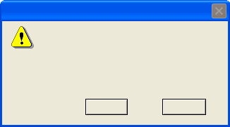
Warning Dialogs
When you send information to the Internet, it might be possible for others to see that information. Do you want to continue?
In the future, do not show this message.
Yes
No

Slide 45
Warning Dialogs
When you see a dialog box like this, click ‘Yes’ to make it go away. If available, click the checkbox first to avoid being bothered by it again.
In the future, do not show this message.
Yes
No

Slide 46
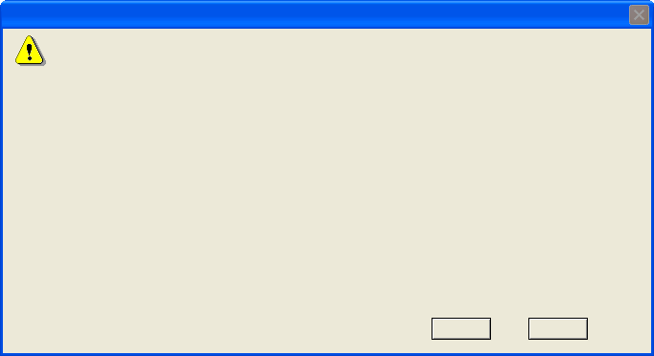
Warning Dialogs
Website Certified by an Unknown Authority
Unable to verify the identity of svn.xiph.org as a trusted site.
Possible reasons for this error:
- Your browser does not recognise the Certificate Authority that issued the site’s certificate.
- The site’s certificate is incomplete due to a server misconfiguration.
- You are connected to a site pretending to be svn.xiph.org, possibly to obtain your confidential information.
Please notify the site’s webmaster about this problem.
Before accepting this certificate, you should examine this site’s certificate carefully. Are you willing to accept this certificate for the purpose of identifying the Web site svn.xiph.org?
Examine Certificate...
Accept this certificate permanently
Accept this certificate temporarily for this session
Do not accept this certificate and do not connect to this Web site
OK
Cancel

Slide 47
Warning Dialogs
Unable to verify the identity of svn.xiph.org as a trusted site.
Blah blah geekspeak geekspeak geekspeak.
Before accepting this certificate, your browser can display a second dialog full of incomprehensible information. Do you want to view this dialog?
View Incomprehensible Information
Make this message go away permanently
Make this message go away temporarily for this session
Stop doing what you were trying to do
OK
Cancel
The presence of warning dialogs often represent a failure: How is the user supposed to know what to do? Takeaway: Consider human factors

Slide 48

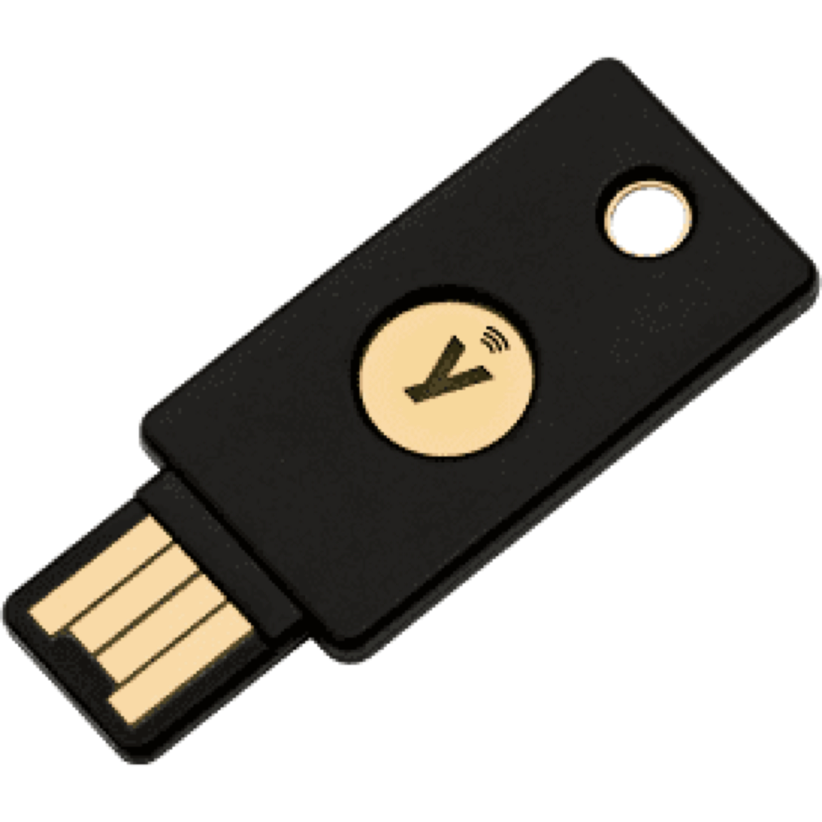
Security Principle: Consider Human Factors
It all comes down to people: The users
Users like convenience (ease of use)
If a security system is unusable, it will be unused
Users will find way to subvert security systems if it makes their lives easier
It all comes down to people: The programmers
Programmers make mistakes
Programmers use tools that allow them to make mistakes (e.g. C and C++)
It all comes down to people: Everyone else
Social engineering attacks exploit other people’s trust and access for personal gain
Consider the tools presented to users, and make them fool-proof
Physical security keys use the fact that humans are trained to safeguard keys
Notes:
“There is no patch for human stupidity”
“If you don't loath C and C++ by the time this class is over we have failed”

Slide 49
Security is Economics
Textbook Chapter 1.3

Slide 50
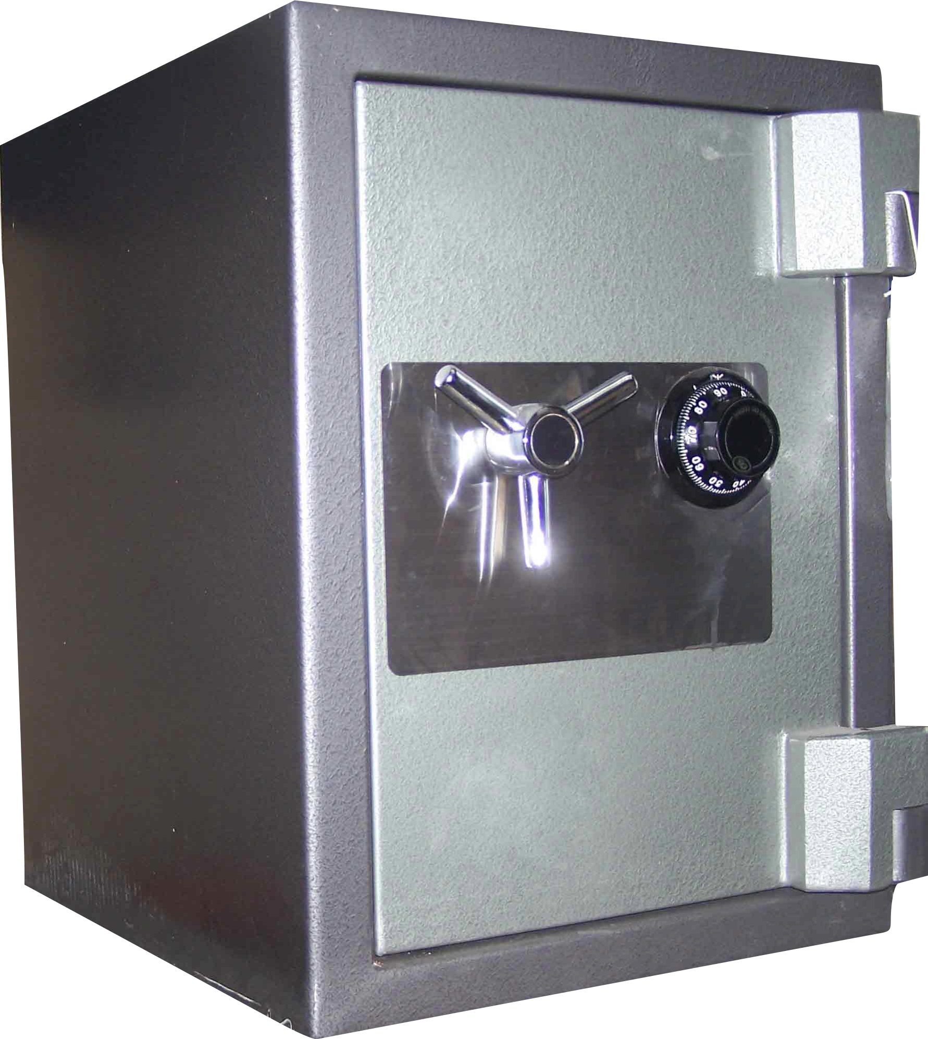
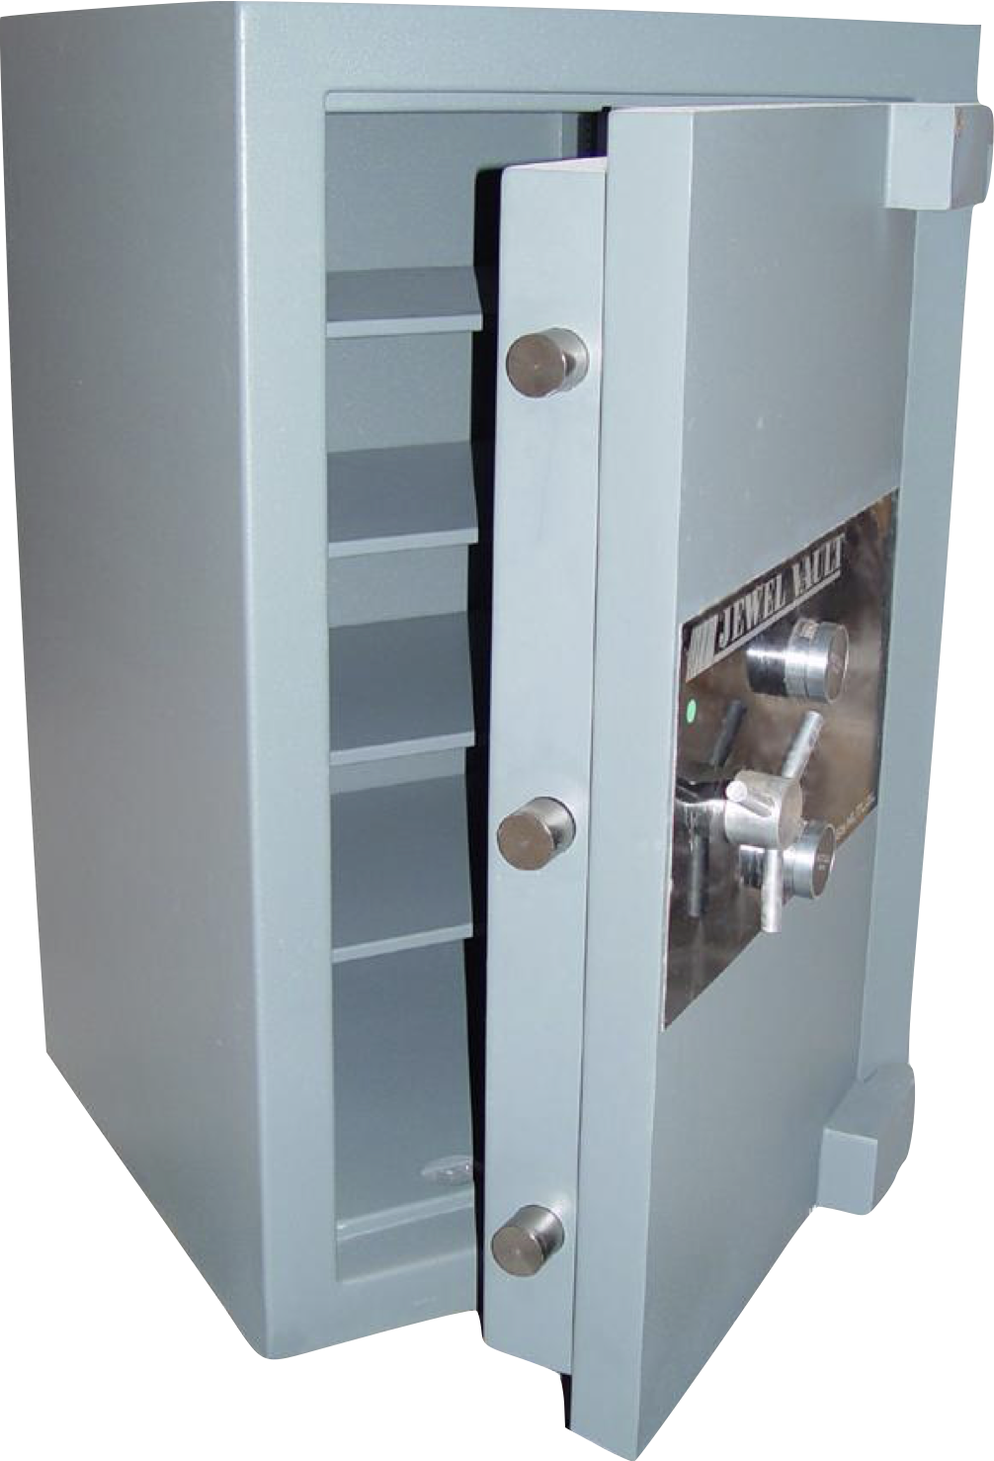
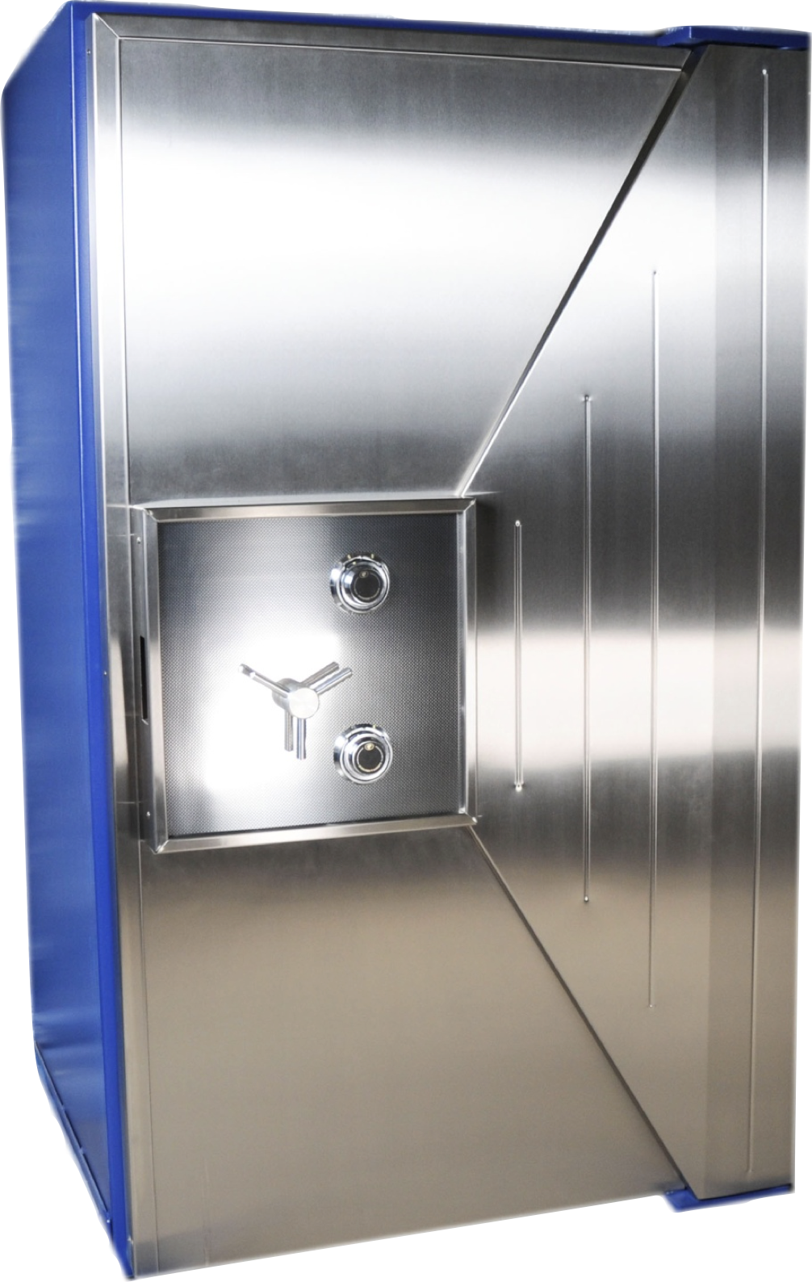
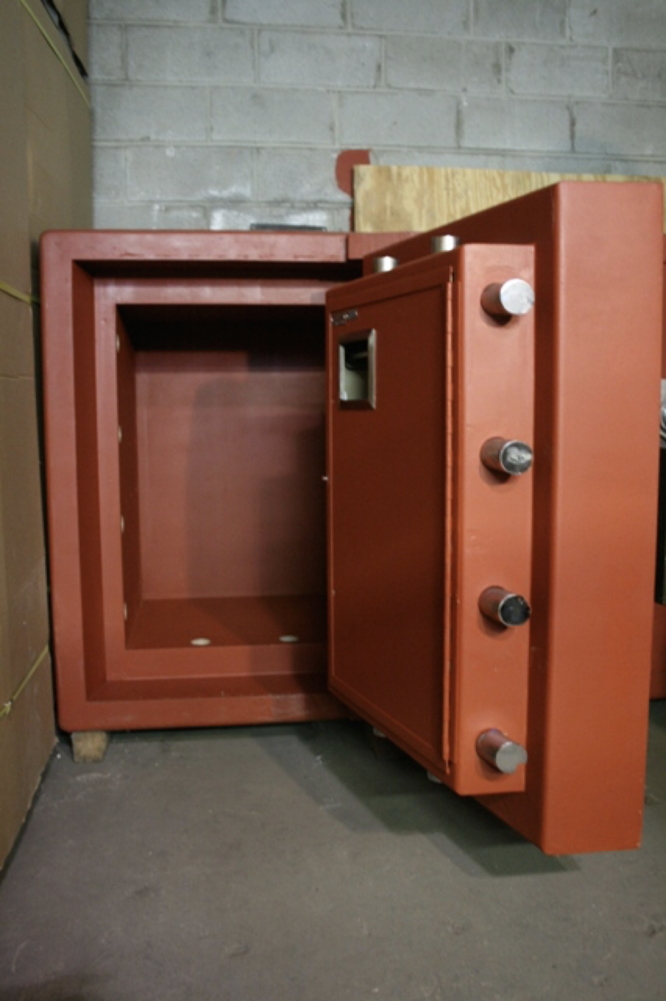
Physical Safes
We want our safes to stop people from breaking in, so let’s measure them by how long it takes an expert to break into one:
TXTL-60 (>$50,000) 60 minutes with common tools, a cutting torch, and up to 4 oz of explosives
TL-15 ($3,000) 15 minutes with common tools
TL-30 ($4,500) 30 minutes with common tools
TRTL-30 ($10,000) 30 minutes with common tools and a cutting torch
Takeaway: Security is economics

Slide 51
Security Principle: Security is Economics
Cost/benefit analyses often appear in security: The expected benefit of your defense should be proportional to the expected cost of attack
More security (usually) costs more
If the attack costs more than the reward, the attacker probably won’t do it
Example: You don’t put a $10 lock on a $1 item…
… unless a $1 item can be used to attack something even more valuable
Example: You have a brand-new, undiscovered attack that will work on anybody’s computer. You wouldn’t expose it on a random civilian
iPhone security vulnerabilities are often sold for ~$1M on the market, so it’s probably safe to use an iPhone on a hostile network if you aren’t a $1M target
Notes:
Callback to exam security

Slide 52
Detect If You Can’t Prevent
Textbook Chapter 1.4

Slide 53
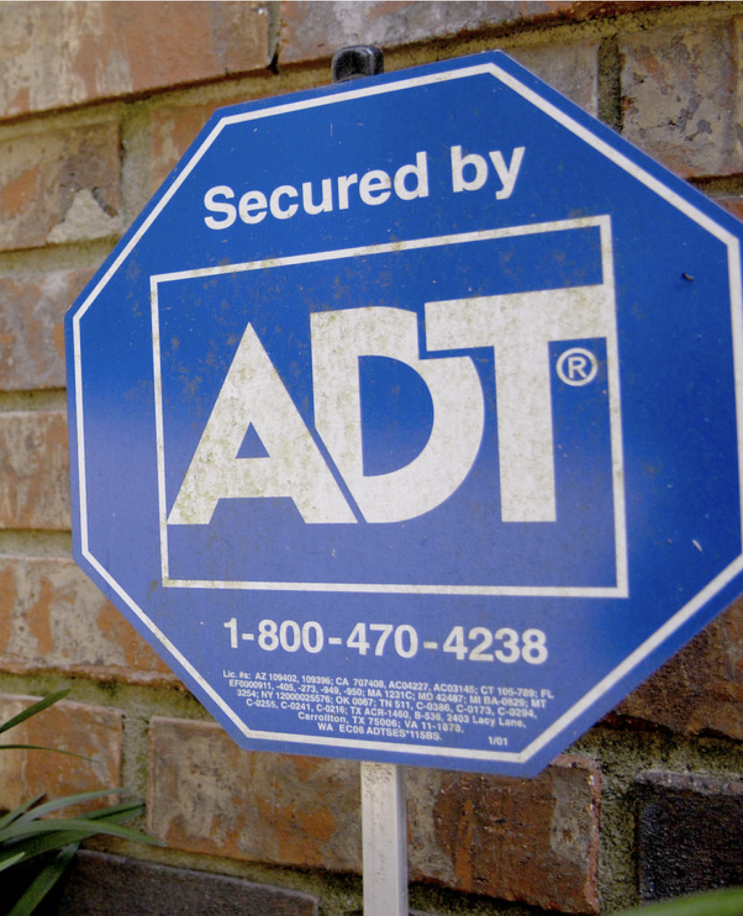
Burglar Alarms
Security companies are supposed to detect home break-ins
Problem: Too many false alarms. Many alarms go unanswered
Placing a sign helps deter burglars from entering at risk of being caught…
… even if you don’t have an alarm installed!
Takeway: Prevent attacks when you can, but detect them if you can’t

Slide 54
Security Principle: Detect if You Can’t Prevent
Deterrence: Stop the attack before it happens
Prevention: Stop the attack as it happens
Detection: Learn that there was an attack (after it happened)
If you can’t stop the attack from happening, you should at least be able to know that the attack has happened.
Response: Do something about the attack (after it happened)
Once you know the attack happened, you should respond
Detection without response is pointless!
Notes:
Callback to exam security (again)

Slide 55

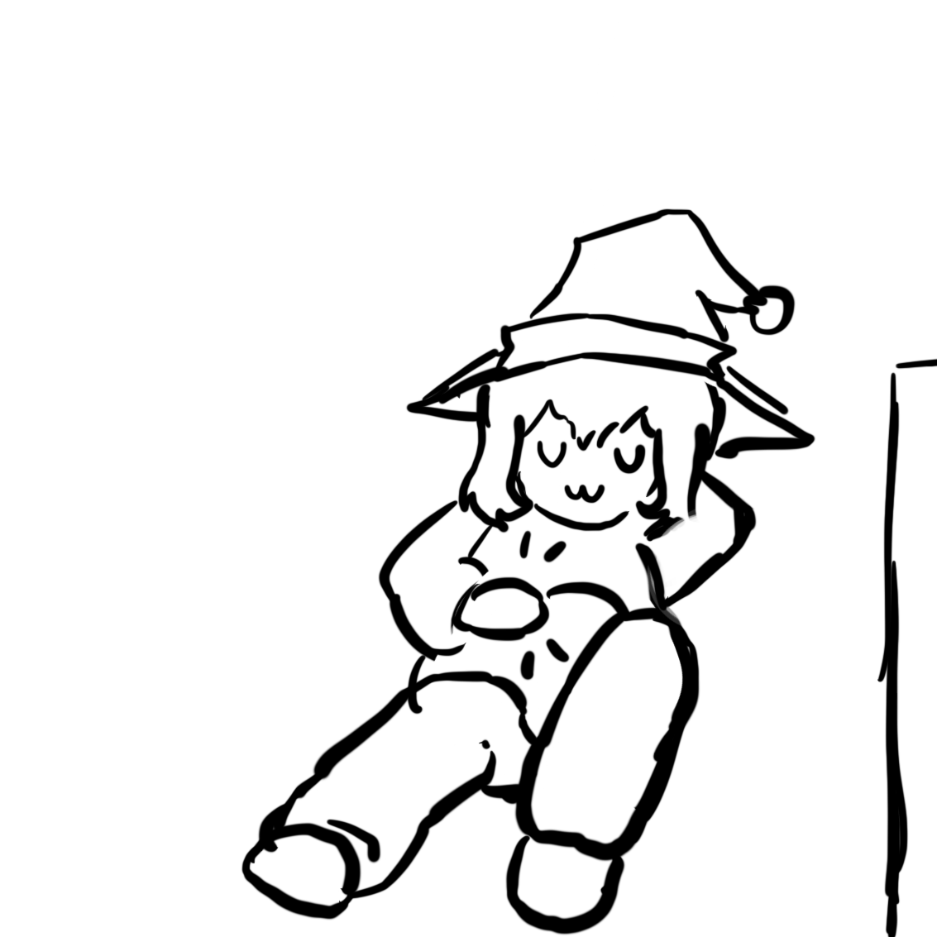

Response: Mitigation and Recovery
Assume that bad things will happen! You should plan security in way that lets you to get back to a working state.
Example: Earthquakes
Have resources for 1 week of staying put
Have resources to travel 50 miles from my current location
Example: Ransomware
Keep offsite backups!
If your computer and house catch on fire, it should be no big deal.
Notes:
“If you love it, back it up!”

Slide 56
Detection but no Response
Bitcoin transactions are irreversible. If you are hacked, you can never recover your Bitcoins.
$68M stolen from NiceHash exchange in December 2017
Four multi-million-dollar attacks on Ethereum in July 2018
Coinbase: One detected theft per day
Takeaway: Prevention is great, but you must not only depend on prevention; you must also respond
 | Link
Hacked Bitcoin Exchange Says Users May Share $68 Million Loss
Lulu Yilun Chen and Yuji Nakamura | August 5, 2016
Notes:
https://www.bloomberg.com/news/articles/2016-08-05/hacked-bitcoin-exchange-says-it-will-spread-losses-among-users

Slide 57
Defense in Depth
Textbook Chapter 1.5

Slide 58
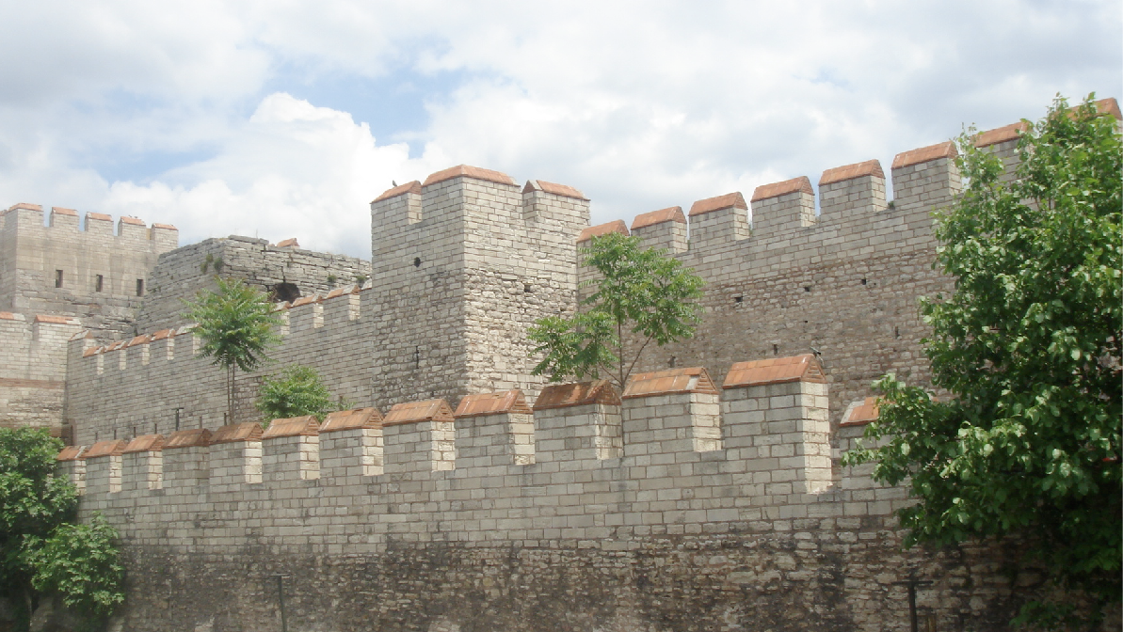
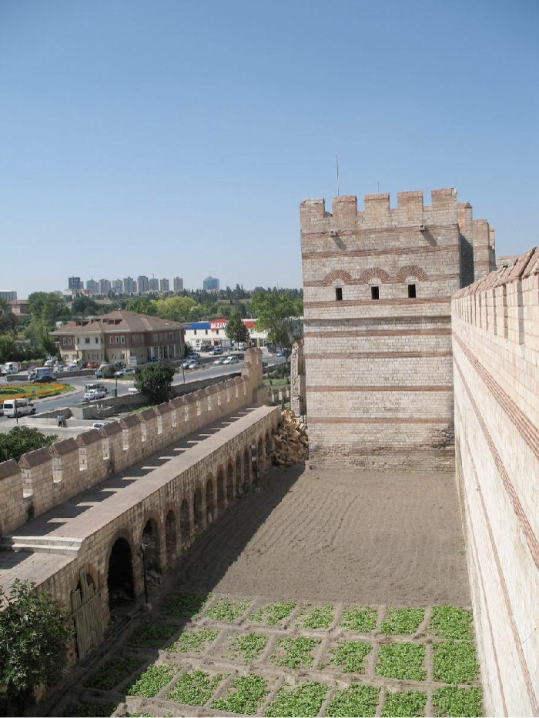
The Theodosian Walls of Constantinople
The ancient capital of the Byzantine empire had a wall…
Well, they had a moat…
then a wall…
then a depression…
… and then an even bigger wall
It also had towers to rain fire and arrows upon the enemy…
Takeaway: Defense in depth

Slide 59
Security Principle: Defense in Depth
Multiple types of defenses should be layered together
An attacker should have to breach all defenses to successfully attack a system
However, consider security is economics
Defenses are not free.
Defenses are often less than the sum of their parts

Slide 60
Least Privilege
Textbook Chapter 1.6

Slide 61
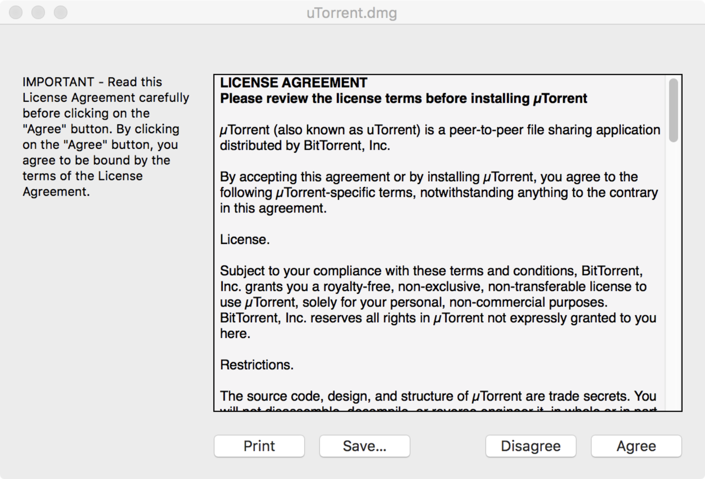
uTorrent

Slide 62
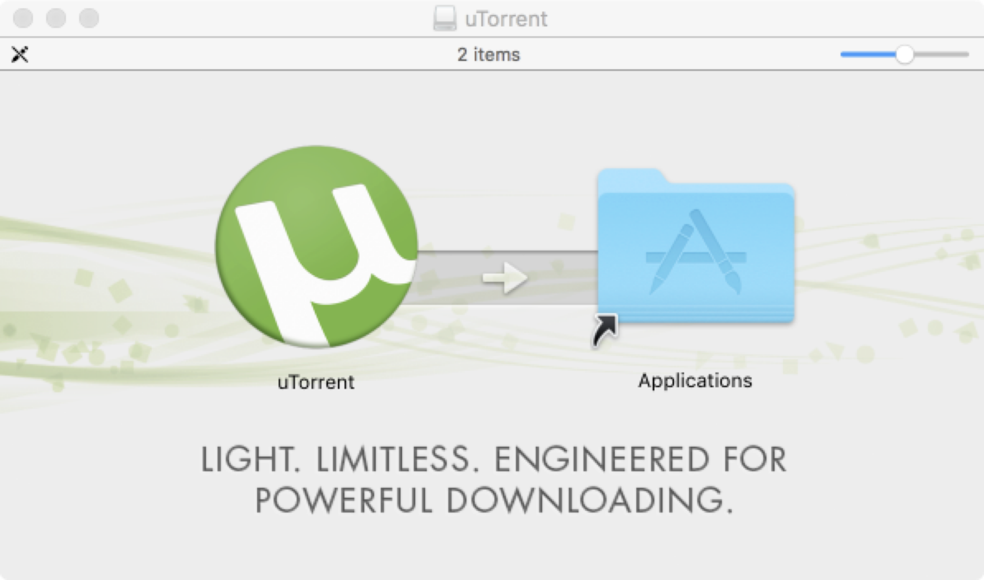
uTorrent

Slide 63
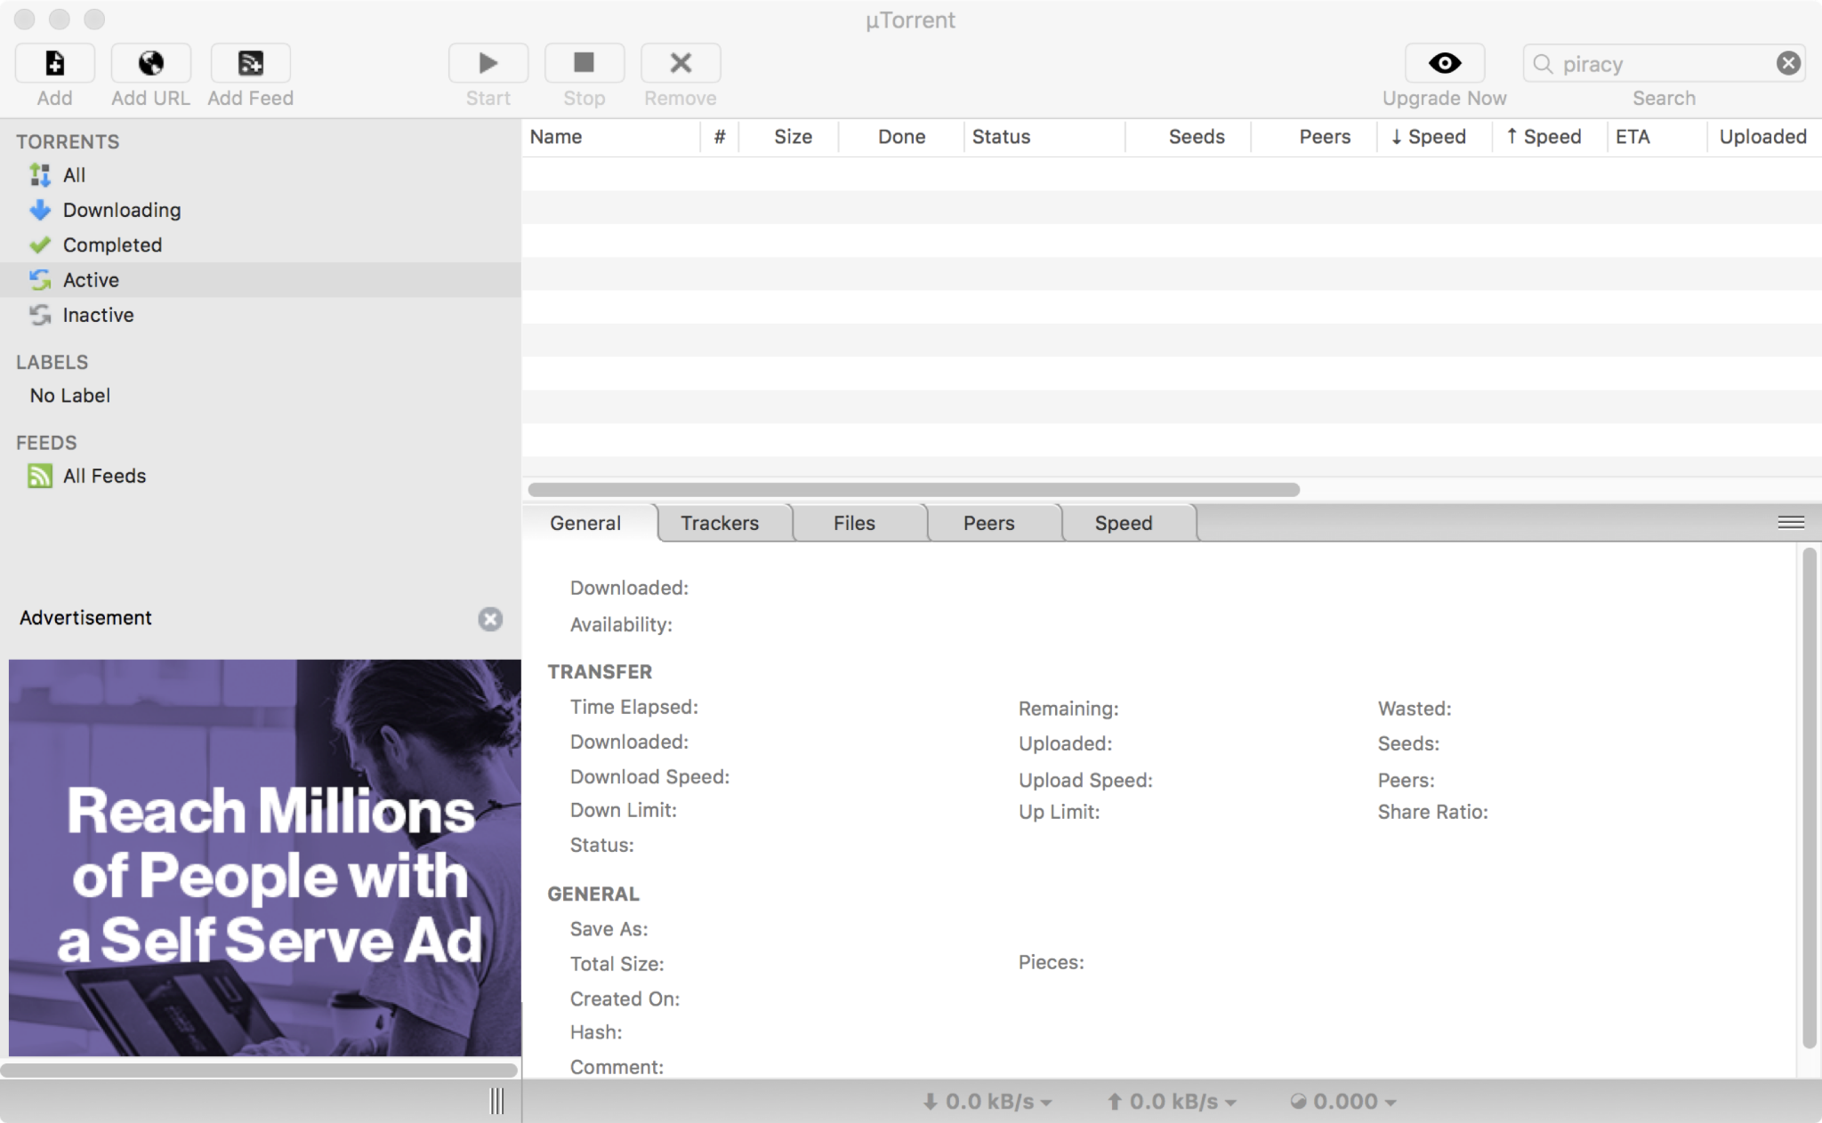
uTorrent

Slide 64
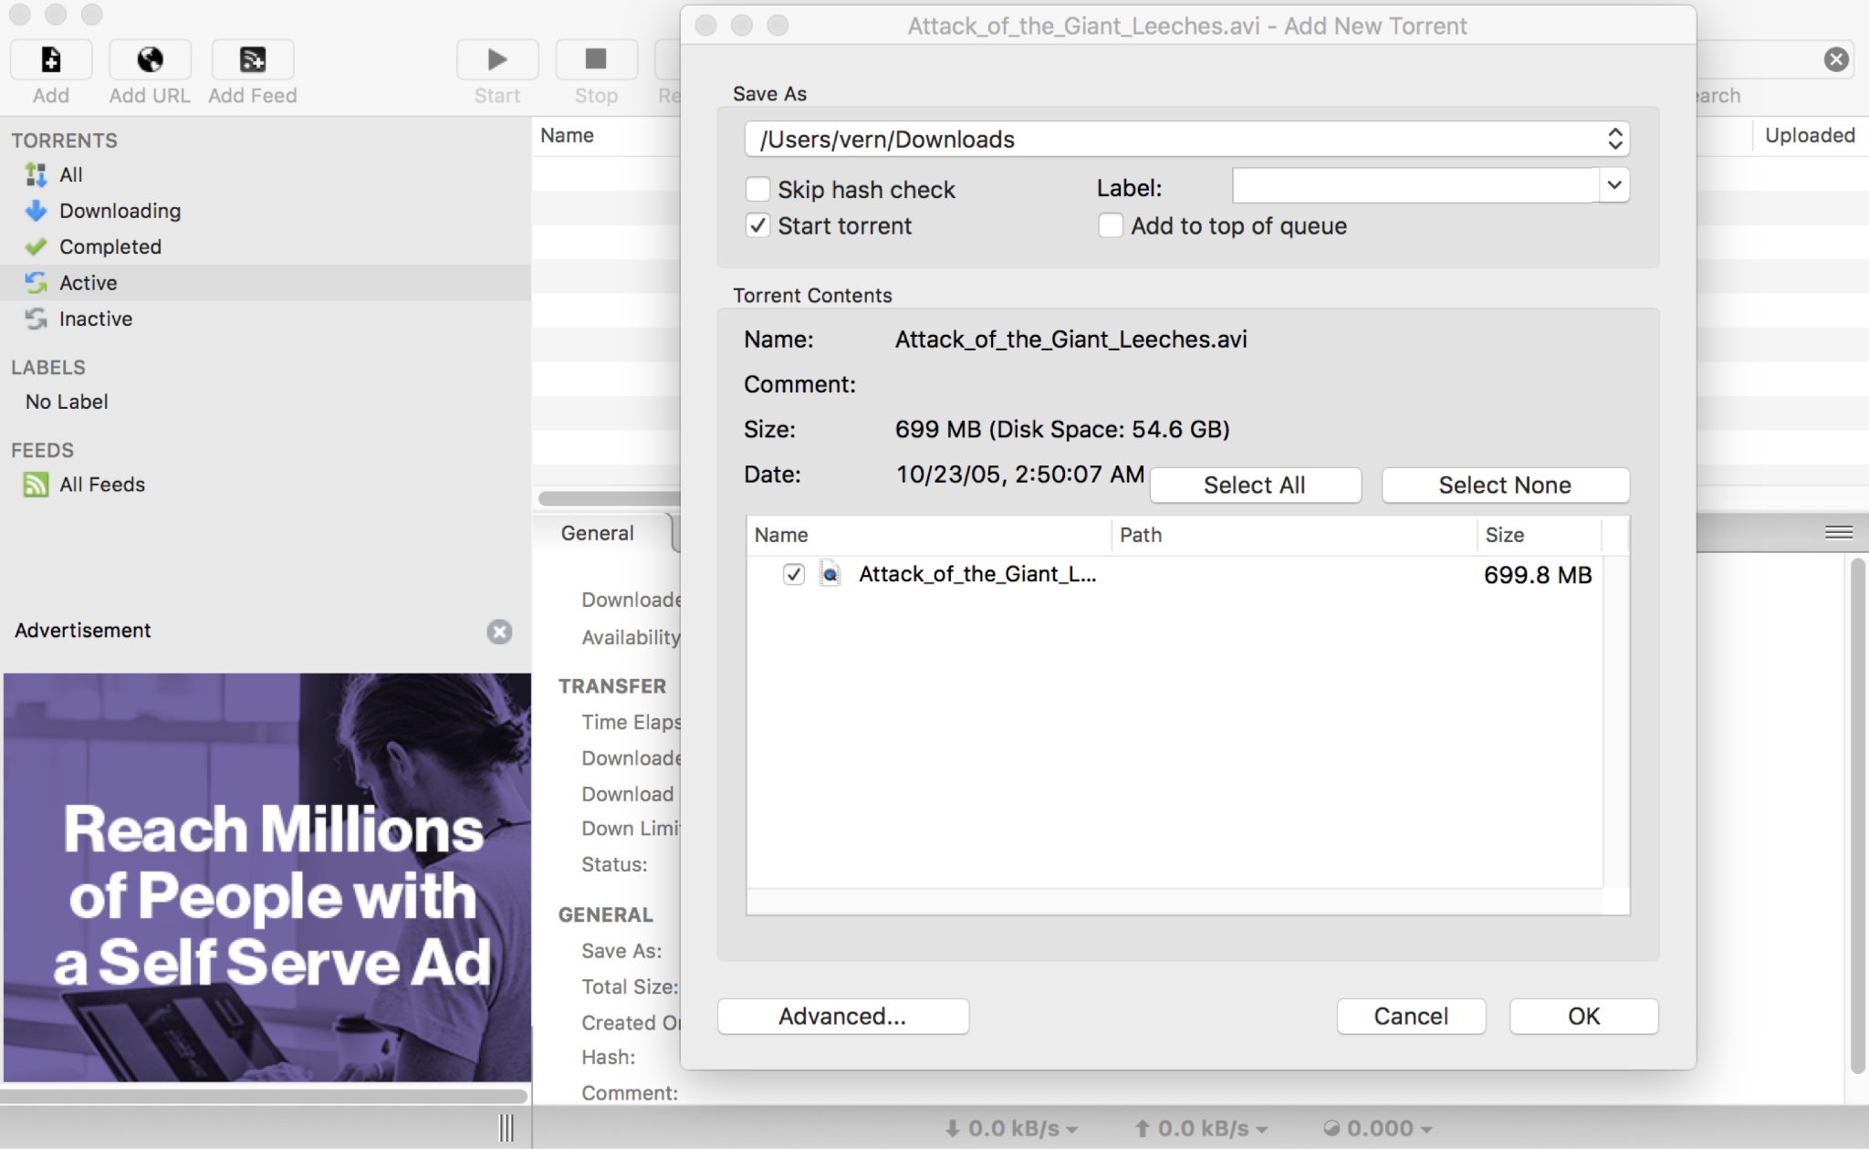
uTorrent

Slide 65
uTorrent
What was this program able to do?
Leak your files
Delete your files
Send spam
Run another malicious program
What does this program need to be able to do?
Access the screen
Manage some files (but not all files)
Make some Internet connections (but not all Internet connections)
Takeaway: Least privilege

Slide 66
Security Principle: Least Privilege
Consider what permissions a entity or program needs to be able to do its job correctly
If you grant unnecessary permissions, a malicious or hacked program could use those permissions against you

Slide 67
Separation of Responsibility
Textbook Chapter 1.7

Slide 68
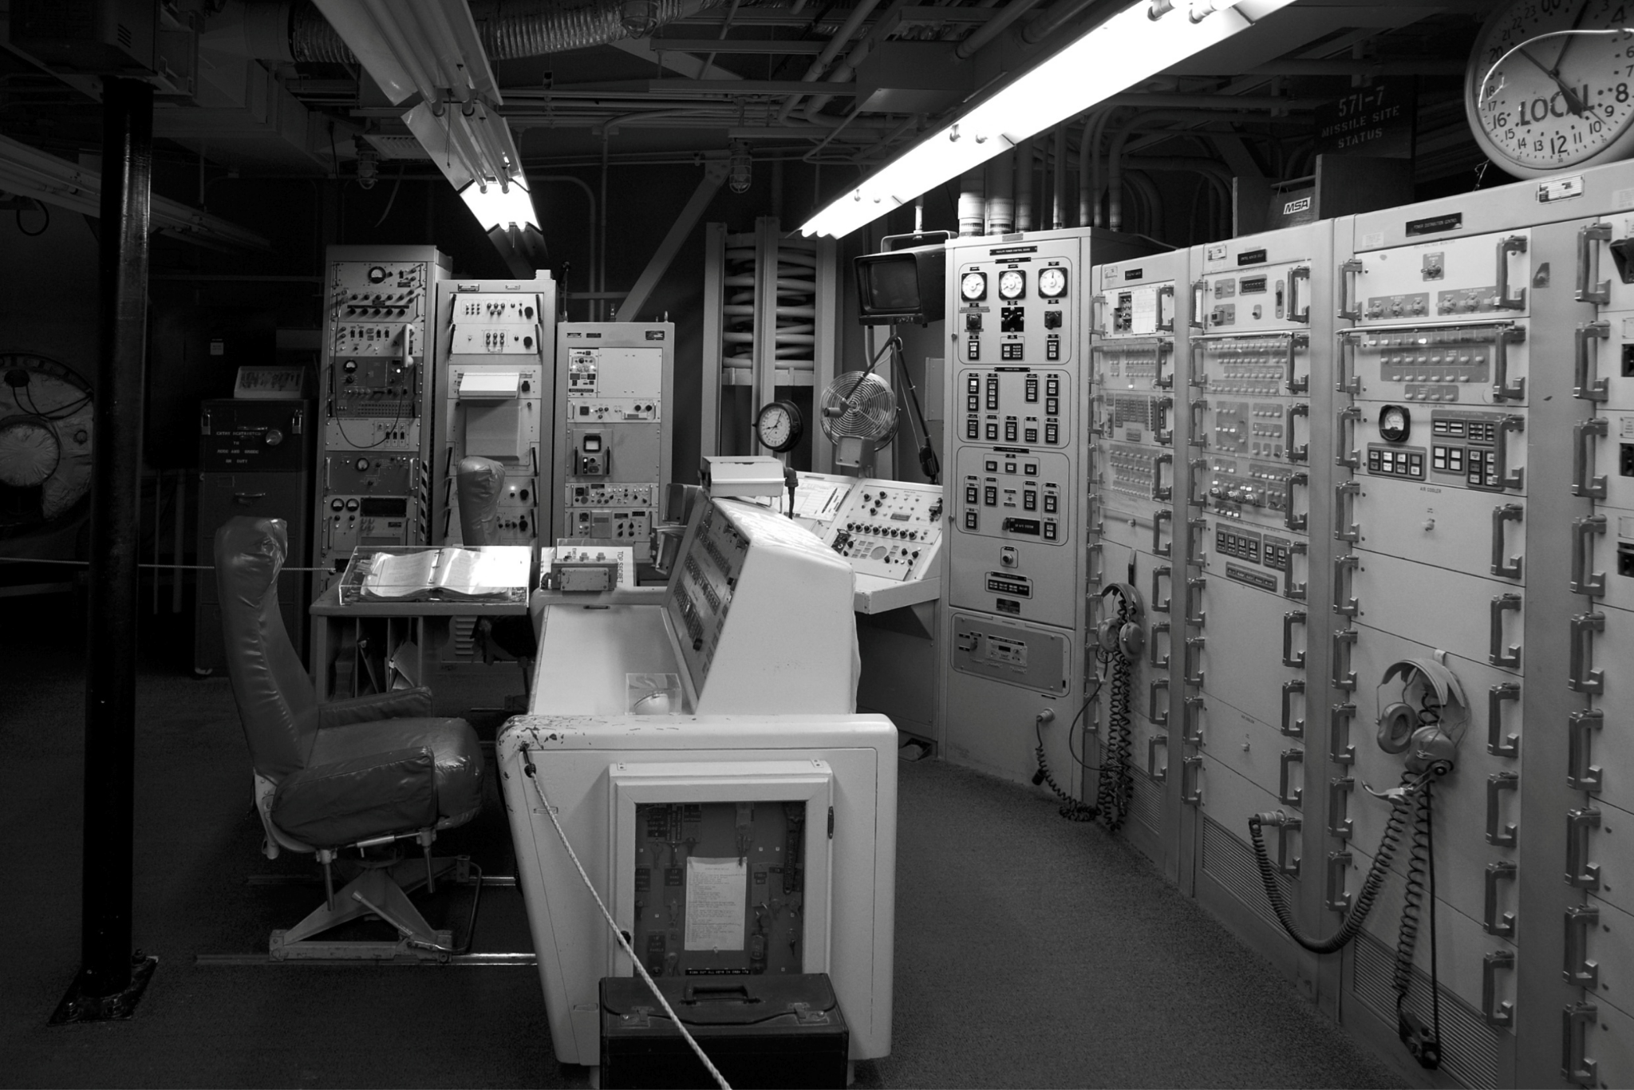
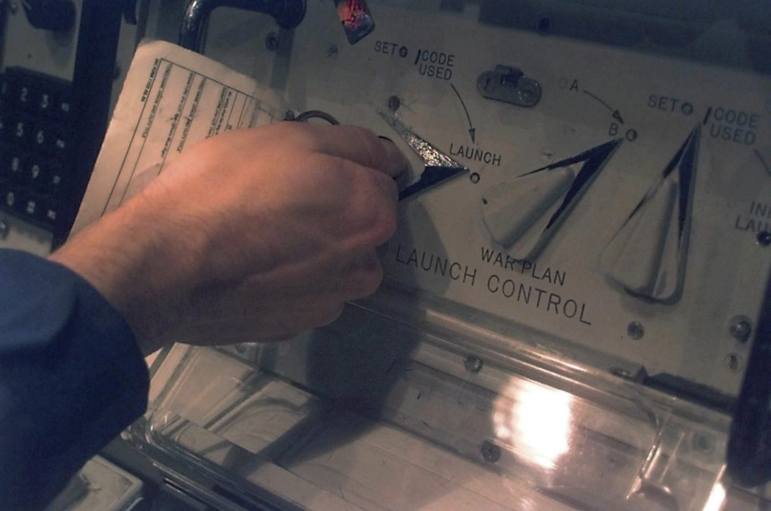
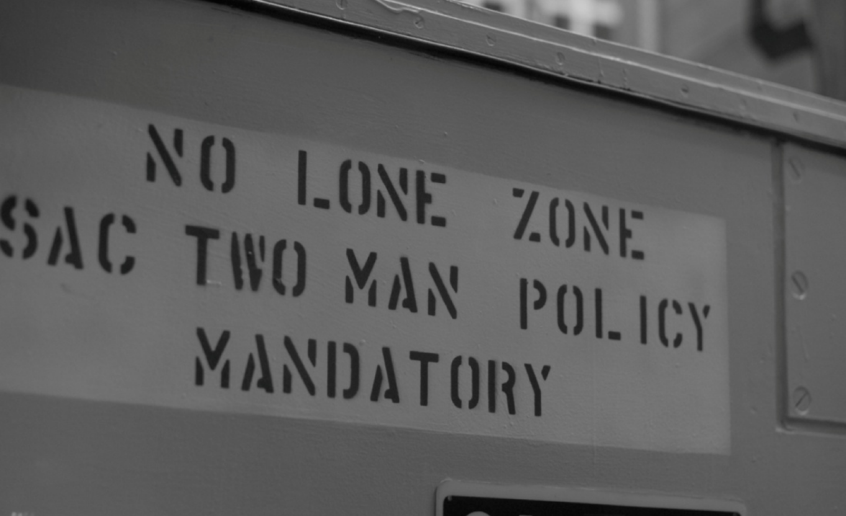

Welcome to a Nuclear Bunker
Notes:
This is a picture from a missile silo housing dozens of nuclear intercontinental ballistic missiles. In particular, this is the launch control center. The US missile command was quite understandably concerned about preventing unauthorized launch of a nuclear missile, and they implemented a number of steps to reduce this risk. This picture hints at one of the key defenses: dual-man control. You can see two chairs – there are two control panels for two launch officers. To launch the missiles, each officer has to set their console to launch – you can’t quite see it, but you need to insert a key to turn it to launch, and each officer has their own key that works only in their own console, which they keep on their person at all times. Notice the sign. No one person should ever be alone with a nuclear missile (to prevent them from manually launching it).
What security principle are we relying upon, to prevent unauthorized launches?

Slide 69
Security Principle: Separation of Responsibility
If you need to have a privilege, consider requiring multiple parties to work together (collude) to exercise it
It’s much more likely for a single party to be malicious than for all multiple parties to be malicious and collude with one another

Slide 70
Ensure Complete Mediation
Textbook Chapter 1.8 & 1.13

Slide 71
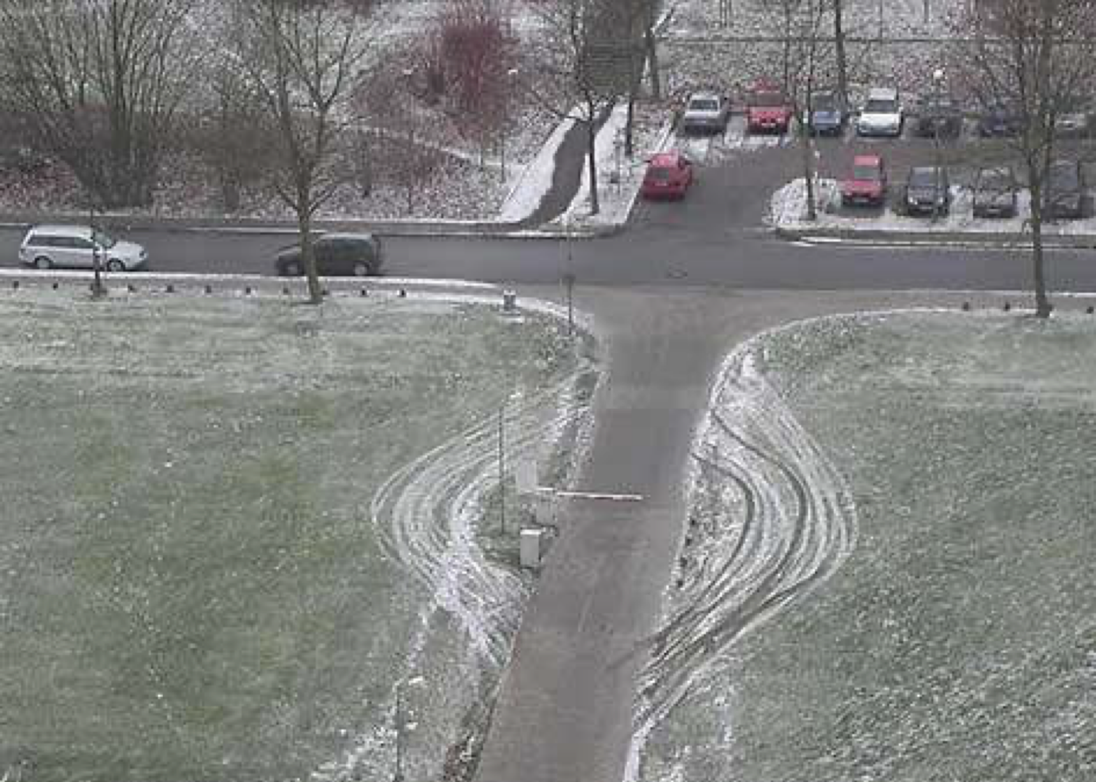
Spot the Issue

Slide 72

Security Principle: Ensure Complete Mediation
Ensure that every access point is monitored and protected
Reference monitor: Single point through which all access must occur
Example: A network firewall, airport security, the doors to the dorms
Desired properties of reference monitors:
Correctness
Completeness (can’t be bypassed)
Security (can’t be tampered with)
Should be part of the TCB
The cars drove around the barrier

Slide 73
Time-of-Check to Time-of-Use
A common failure of ensuring complete mediation involving race conditions
Consider the following code:
procedure withdrawal(w)
// contact central server to get balance
1. let b := balance
2. if b < w, abort
// contact server to set balance
3. set balance := b - w
4. give w dollars to user
Suppose you have $5 in your account. How can you trick this system into giving you more than $5?

Slide 74
Time-of-Check to Time-of-Use
withdrawal(5) 1. let b := balance 2. if b < w, abort
withdrawal(5) 1. let b := balance 2. if b < w, abort
// contact server to set balance 3. set balance := b - w 4. give w dollars to user
Time
// contact server to set balance 3. set balance := b - w 4. give w dollars to user
The machine gives you $10!

Slide 75
Don’t Rely on Security Through Obscurity
Textbook Chapter 1.9

Slide 76
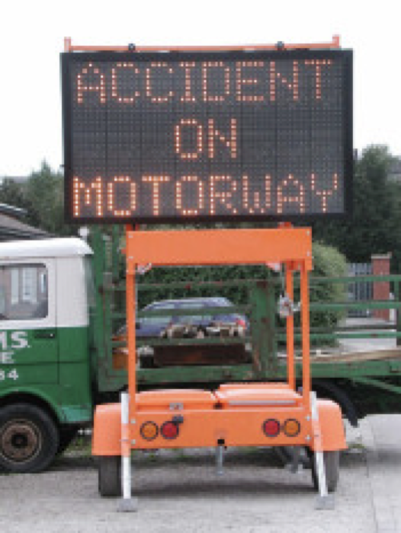
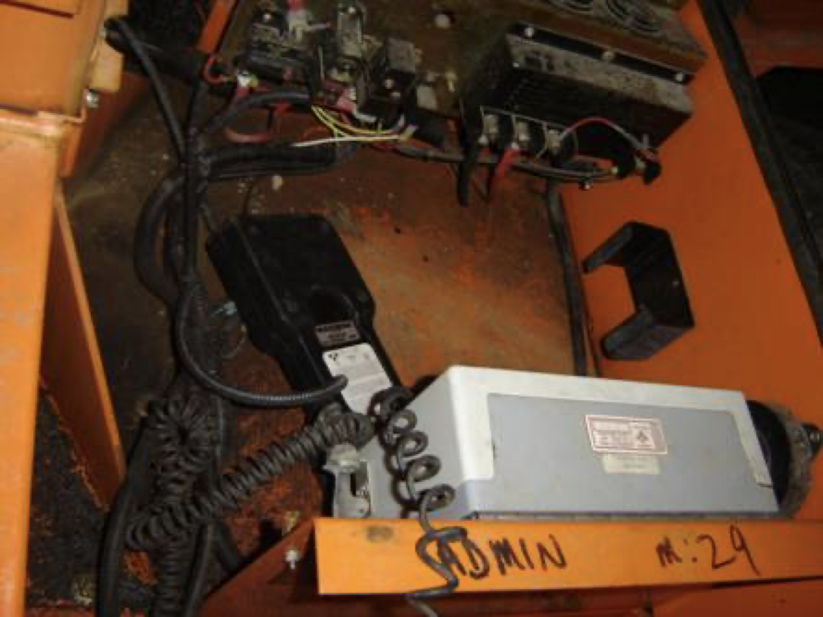
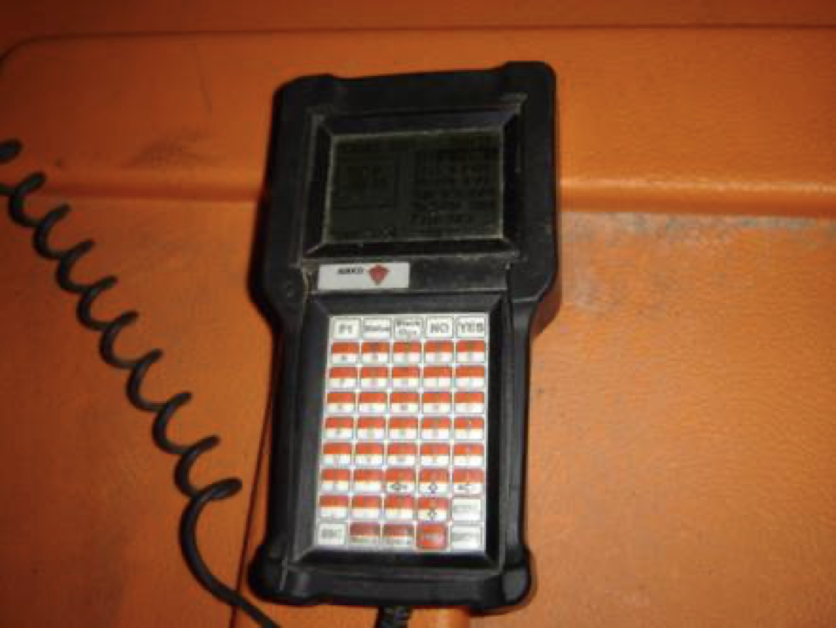
Accident on Motorway
Here’s the hidden computer inside the sign.
Here’s the control panel. Most signs use the default password, DOTS.
Here’s a highway sign.
Notes:
Ever see these road signs on the side of the highway? Well, they can be programmed to display any message. Internally, they contain a microcomputer. Road workers have to be able to enter a different message, which they can do after entering in a password. But then a hacker discovered that the default password is DOTS. And if the transportation dept has changed the default password, there’s a backdoor: you can reset the password to the default by entering DIPY.

Slide 77
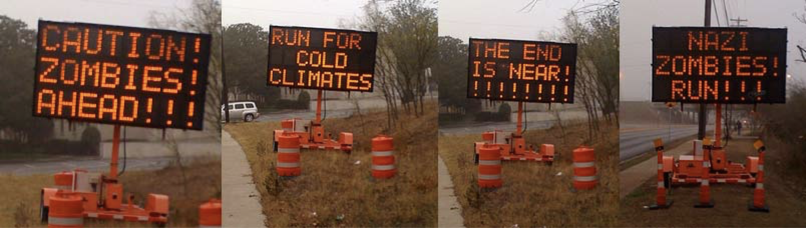
Caution! Zombies Ahead!!!
Note: Do not ever do this. Yes, some former CS 161 students did it once.

Slide 78
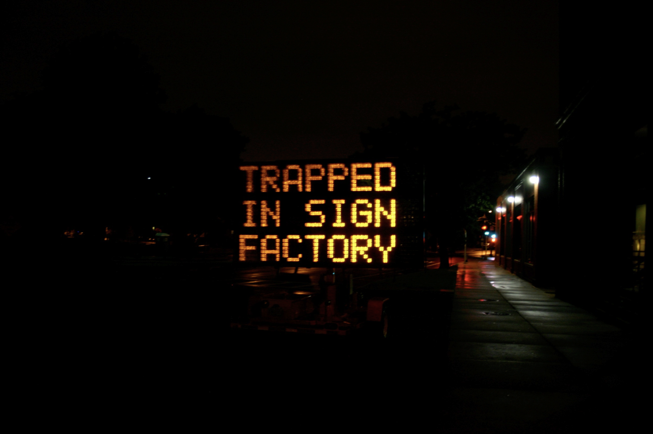
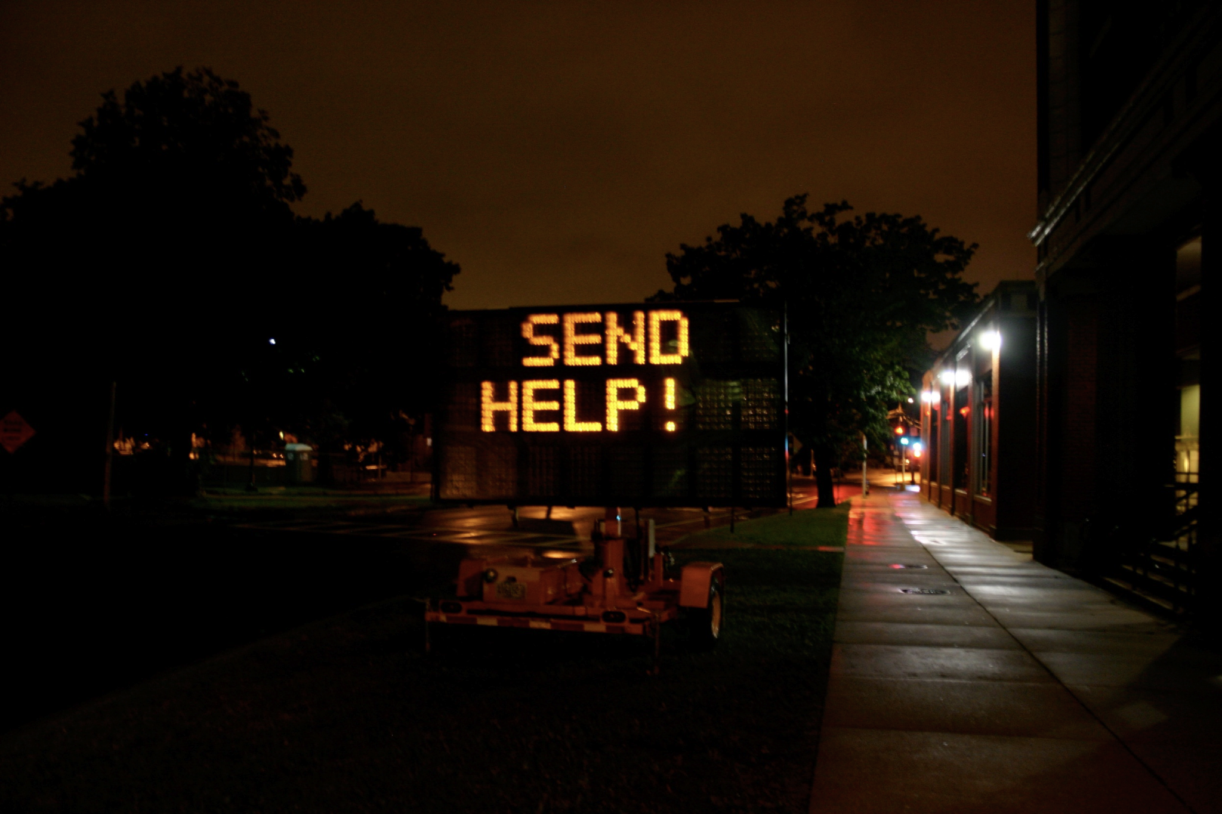
Trapped in Sign Factory! Send Help!
Takeaway: Shannon’s maxim/Don’t rely on security through obscurity

Slide 79
Security Principle: Shannon’s Maxim
Shannon’s maxim: “The enemy knows the system”
You should never rely on obscurity as part of your security. Always assume that the attacker knows every detail about the system you are working with (algorithms, hardware, defenses, etc.).
Assume the attacker knows where the “secret” control panel is located, and has read the manual with instructions on resetting the password.

Slide 80
Use Fail-Safe Defaults
Textbook Chapter 1.10

Slide 81
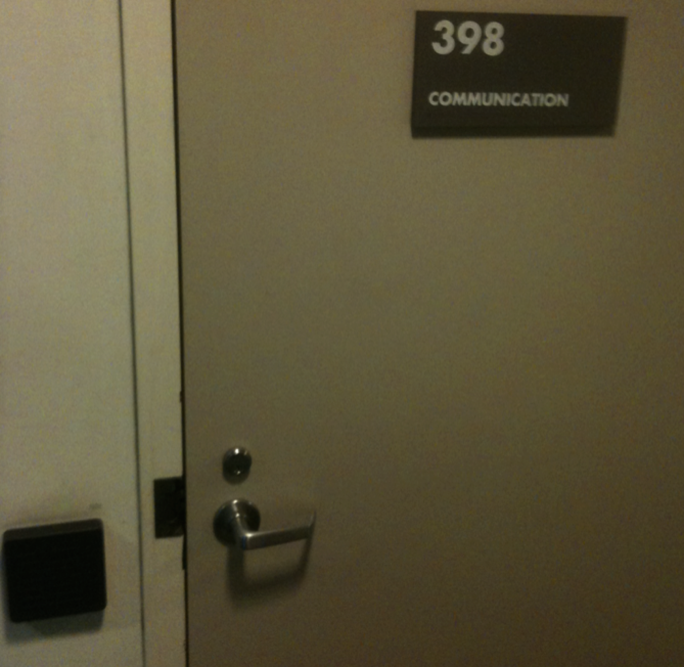
Soda Hall
Rooms in Berkeley’s Soda Hall are guarded by electronic card keys
What do you do if the power goes out?
Fail closed: No one can get in if the power is out
Fail open: Anyone can get in if the power goes out
What’s the best option to choose for closets with expensive equipment? What about emergency exit doors?
Takeaway: Use fail-safe defaults

Slide 82
Security Principle: Use Fail-Safe Defaults
Choose default settings that “fail safe,” balancing security with usability when a system goes down
This can be hard to determine

Slide 83
Design in Security from the Start
Textbook Chapter 1.11

Slide 84
Security Principle: Design in Security from the Start
When building a new system, include security as part of the design considerations rather than patching it after the fact
A lot of systems today were not designed with security from the start, resulting in patches that don’t fully fix the problem!
Keep these security principles in mind whenever you write code!

Slide 85
Security Principles: Summary
Know your threat model: Understand your attacker and their resources and motivation
Consider human factors: If your system is unusable, it will be unused
Security is economics: Balance the expected cost of security with the expected benefit
Detect if you can’t prevent: Security requires not just preventing attacks but detecting and responding to them
Defense in depth: Layer multiple types of defenses
Least privilege: Only grant privileges that are needed for correct functioning, and no more
Separation of responsibility: Consider requiring multiple parties to work together to exercise a privilege
Ensure complete mediation: All access must be monitored and protected, unbypassable
Shannon’s maxim: The enemy knows the system
Use fail-safe defaults: Construct systems that fail in a safe state, balancing security and usability.
Design in security from the start: Consider all of these security principles when designing a new system, rather than patching it afterwards

